Slide 1
Lab 3 Datapath
Vinay Vazir
Jason Reynolds

Slide 2
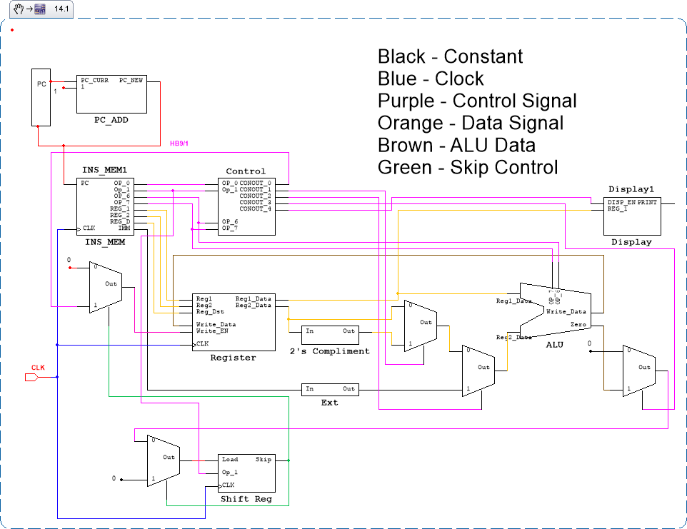
DataPath

Slide 3
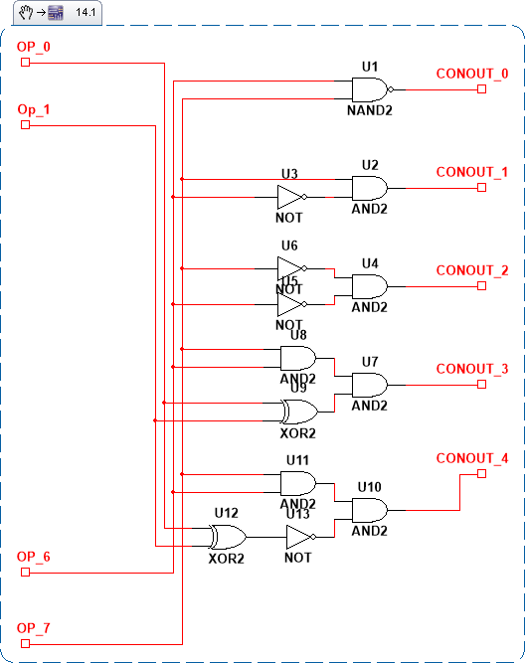
Control Signals

